Slide 1
Developing a sensing area visualisation tool for laparoscopic drop-in gamma prob
Supervisor: Prof. Daniel Elson
Group members:
Yiyang Liu
Yiping Li
Wenkang Li
Muhammad Oktavian

Slide 2
Last Week Outline
Marker Detection
Solved the x,y shift problem found last week
Marker Detection test with the lens
The same program appears to still function even with the lens attached.
Not able to solve the RGB-D calibration
GUI design
Looked up GUI libraries and discussed which to be used
Decided how to visualize the pose
Added some GUI functions
Problems
RGB to Depth Calibration with lens（Intrinsic matrix may changed for the RGB, Deepth, RGB to Deepth and Depth to RGB）
Getting ground truth data

Slide 3
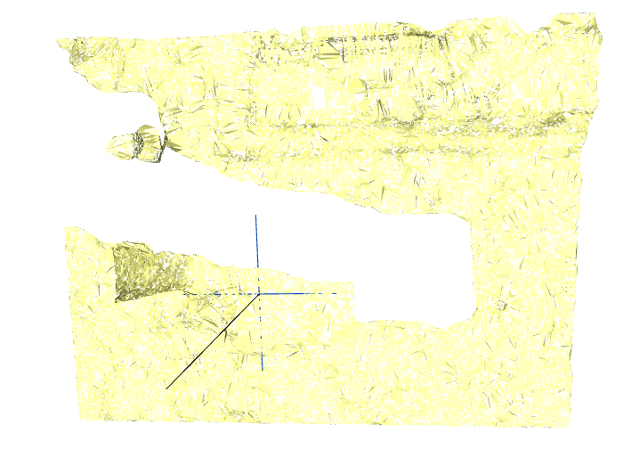
Sensing Area
Notes:
Realsense function – deproject point to pixel – camera intrinsics, x,y pixel location, depth of point of interest

Slide 4
Sensing Area
Notes:
Realsense function – deproject point to pixel – camera intrinsics, x,y pixel location, depth of point of interest

Slide 5
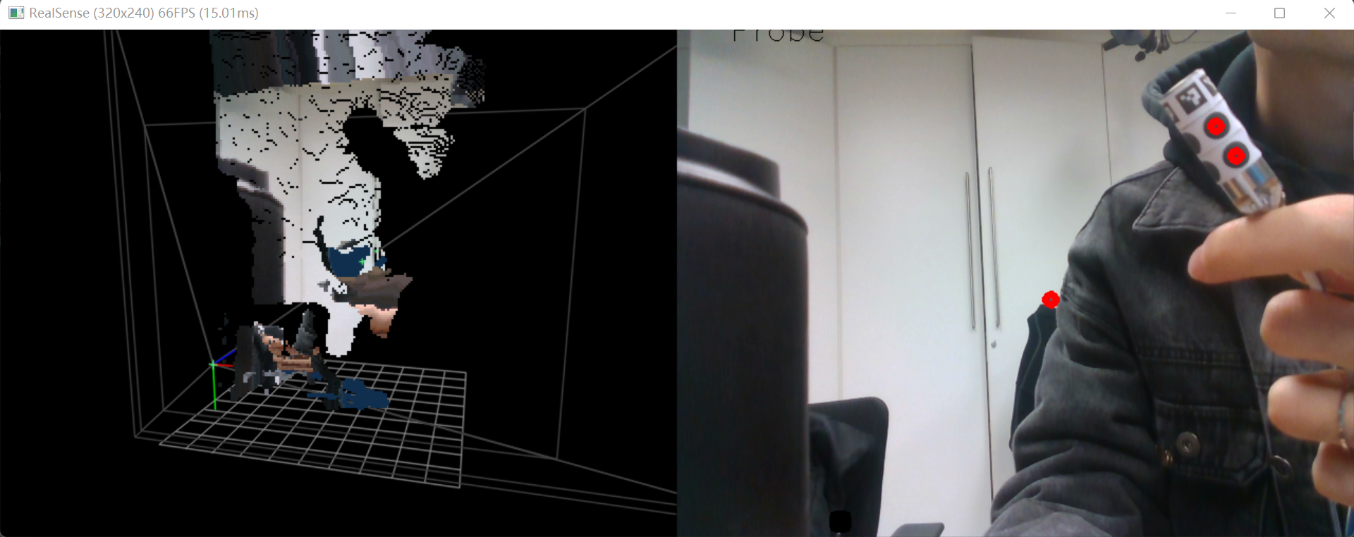
GUI design

Slide 6
Plan for this week
Complete pose calculation based on Aruco
Sensing area calculation
GUI design
Find the suitable shell for lens

Slide 7
14/11 – 18/11 Log
2022/11/14 (2pm — 6pm)
Project meeting with Prof. Dan
Solved the x,y shift problem found last week
Changed the code to detect Aruco markers and display a plus sign on the centre of the Aruco markers in the 3D point cloud.
Started working on camera calibration with lens
2022/11/15 (2pm — 6pm)
Started working on the GUI
Started working on pose estimation programs
Researched RGB to D calibration with lens but didn't get solutions
Discussed with TA Kaizhong and decided the plan: work on GUI, pose estimation and only calibrate the RGB camera (might try to get a transformation matrix between results with lens and without lens)
2022/11/17 (10am — 1pm)
Looked up GUI libraries and discussed which to be used
Decided how to visualize the pose
2022/11/18 (10am — 1pm)
Worked on Aruco pose calculation
Added GUI functions
Finalised marker design

